Slide 1

Superstore Sales Analysis

Slide 2
Introduction
The Superstore Sales Analysis project aims to uncover actionable insights from retail sales data collected over multiple years. The dataset contains detailed records of orders, including sales, profit, quantity, discounts, customer information, product categories, sub-categories, and regional data.
In today’s highly competitive retail landscape, understanding sales performance drivers is critical for maximizing profitability and customer satisfaction. By analyzing this dataset, we can identify sales trends, high-performing products, customer segments, and underperforming regions.
The insights from this project will help the superstore make data-driven decisions to boost revenue, improve operational efficiency, and enhance customer experience.

Slide 3

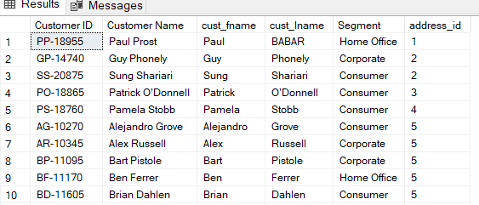
1. Display all information of customer.

Slide 4
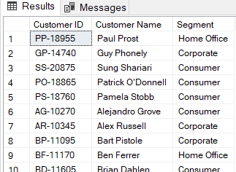
2. Display customer name, customer id and customer segment.

Slide 5
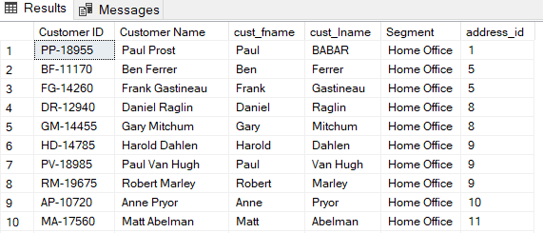
3. Display customer details of Home Office segment.

Slide 6
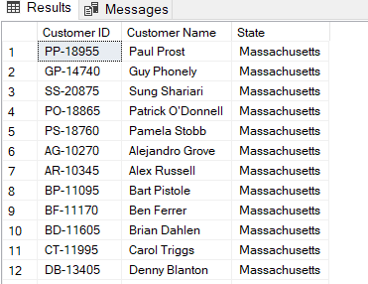
4.Display customer id and customer name whose belong to Massachusetts state

Slide 7
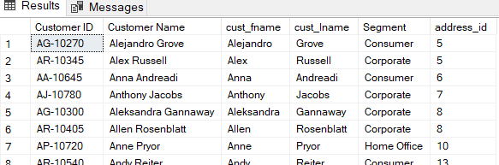
5.Display all customer information whose name starts with A

Slide 8
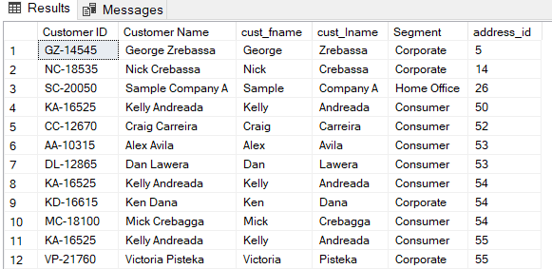
6.Display all customer information whose name end with A.

Slide 9
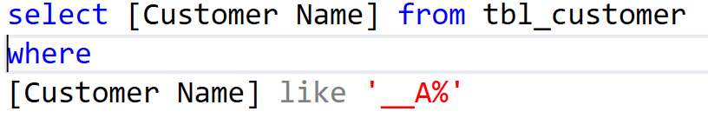
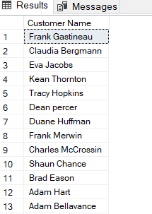
7.Display all customer name whose name contains letter A at 3rd position from start.

Slide 10

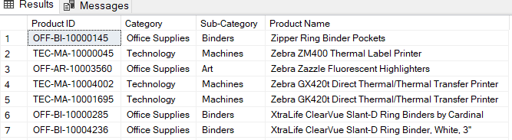
8.Display all product information in Descending order

Slide 11
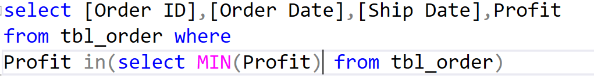
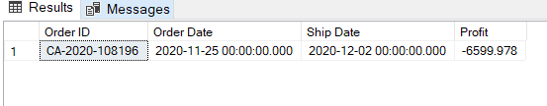
9.Display the lowest profit order

Slide 12
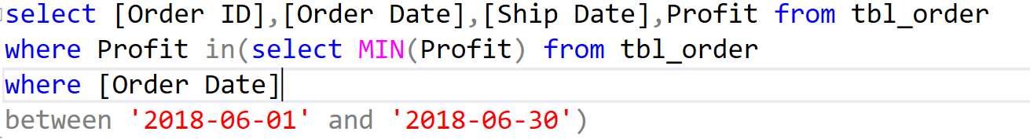
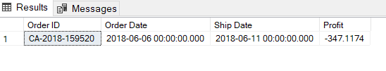
10.Display lowest profit order in the month June 2018.

Slide 13
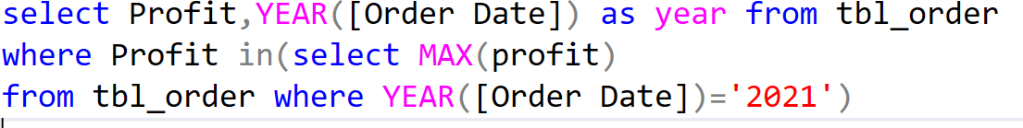
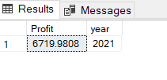
11.Display highest profit order in year 2021

Slide 14
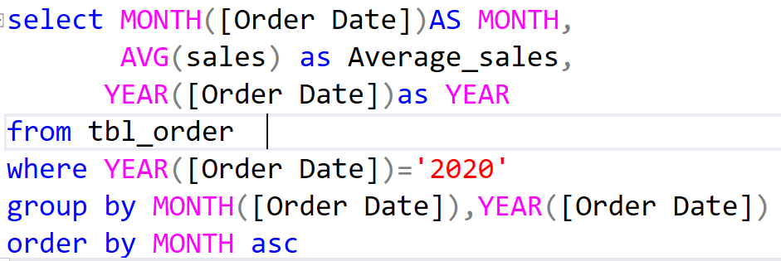
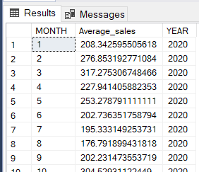
12.Display average sales for each month for 2020

Slide 15
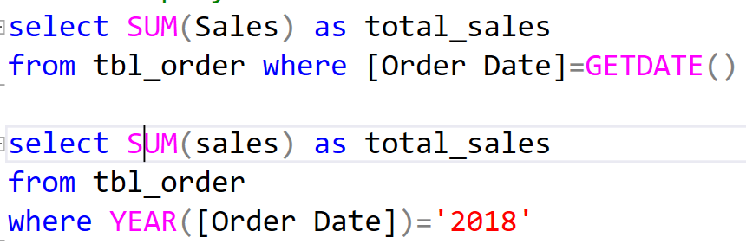
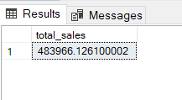
13. display current month total sales

Slide 16
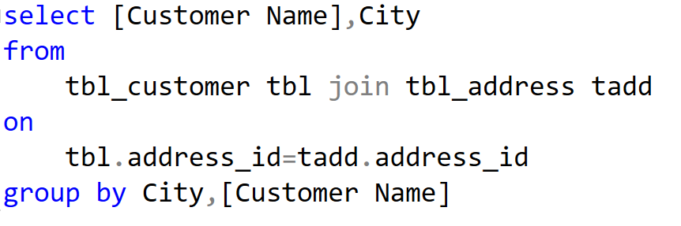
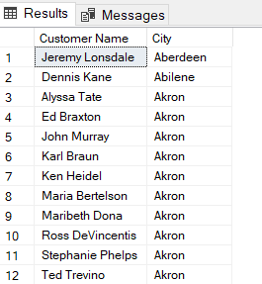
14.Display customer name with customer city

Slide 17
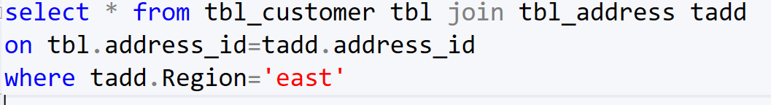
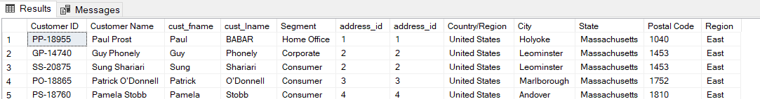
15.Display customer details belong to East region.

Slide 18
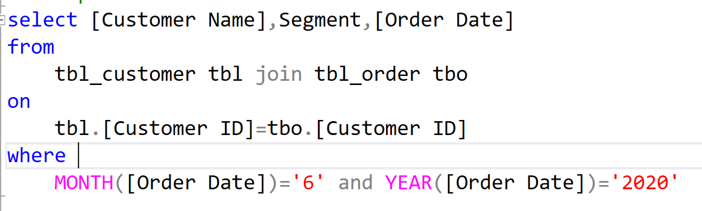
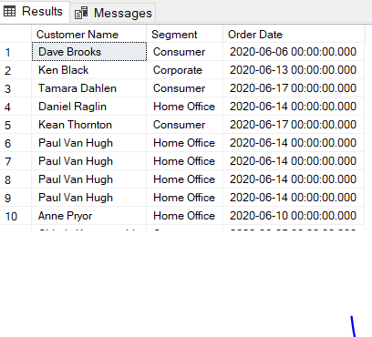
16.Display customer name with segment details,
--who placed order in the month of June 2020

Slide 19
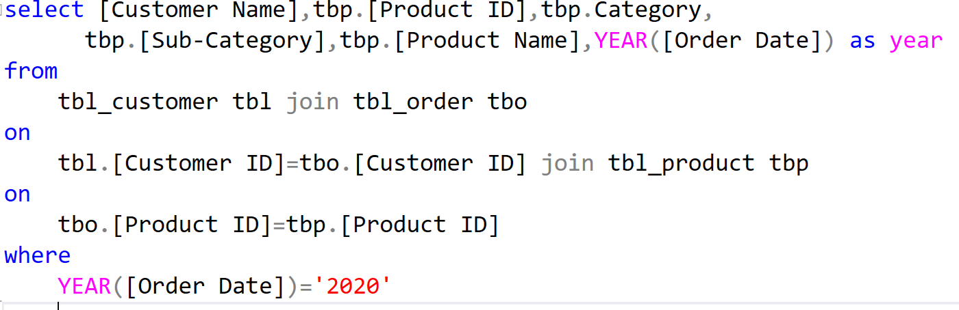
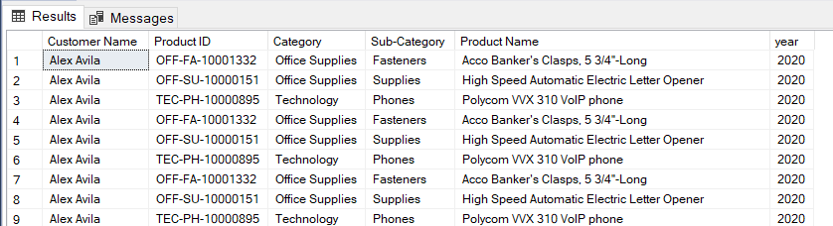
17.Display the customer and product information for the year 2020

Slide 20
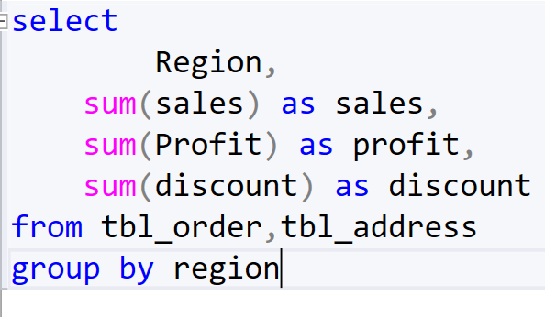
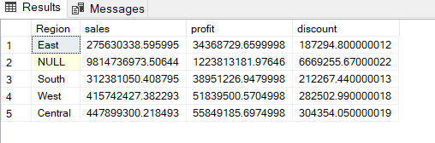
18.Display region wise sales, profit, discount

Slide 21
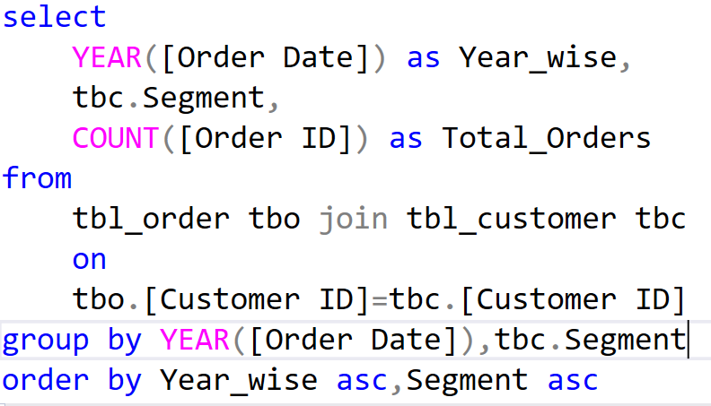
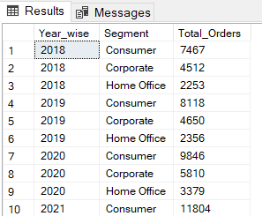
19.Display segment wise total orders for each year.

Slide 22
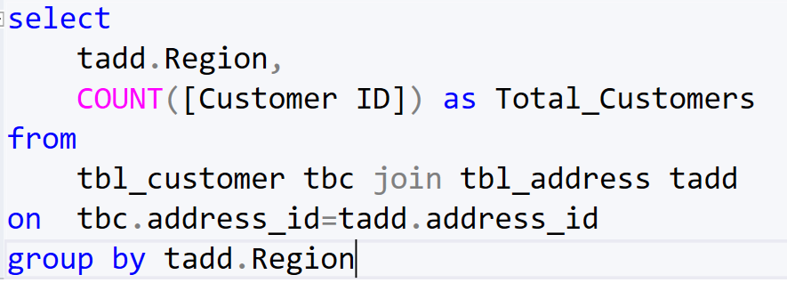
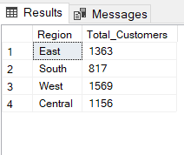
20.Display customer count by each region

Slide 23
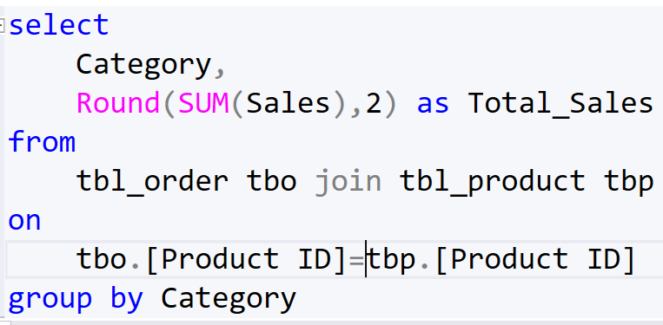
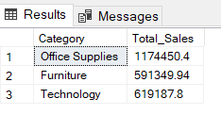
21.Display total sales by category

Slide 24
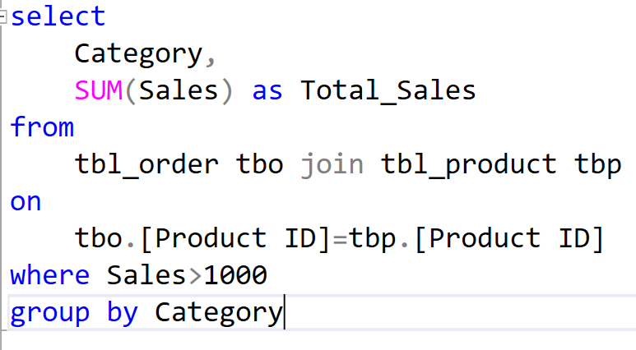
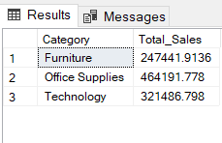
22.Display total sales by category having sales greater than 1000

Slide 25
Thank you

Slide 28



Project Objectives
Analysis Phase
Strategy Development
Analyze sales performance, market trends, and consumer behavior.
Conduct a SWOT analysis of existing sales strategy.
Create new strategies using marketing, sales promotions,
Customer engagement to leverage strengths and opportunities.
Implementation Plan
Create a timeline with milestones
And responsibilities. Set KPIs to measure success.

Slide 29

Expected Outcomes
Increased Sales Figures:
Target a 25% increase in sales over the next years.
Measure success by tracking sales metrics and revenue growth.
Improved Customer Engagement:
Foster stronger relationships with customers through personalized engagement strategies.
Increase customer retention rates and loyalty.
Enhanced Market Reach:
Expand market reach by tapping into new demographics or geographical regions.
Strengthen brand presence through effective marketing campaigns.

Slide 30

Methodology
Data Collection:
Gather sales data, market research, and consumer feedback through surveys and analysis tools.
Utilize both primary and secondary research methods to gather comprehensive insights.
Brainstorming Sessions:
Collaborate to generate innovative ideas for product positioning, pricing, and promotional campaigns.
Consider various channels such as online platforms, partnerships, and offline marketing.
Testing and Refinement:
Pilot the proposed strategies on a smaller scale to assess their effectiveness.
Gather feedback, iterate, and refine the strategies based on initial results.

Slide 31
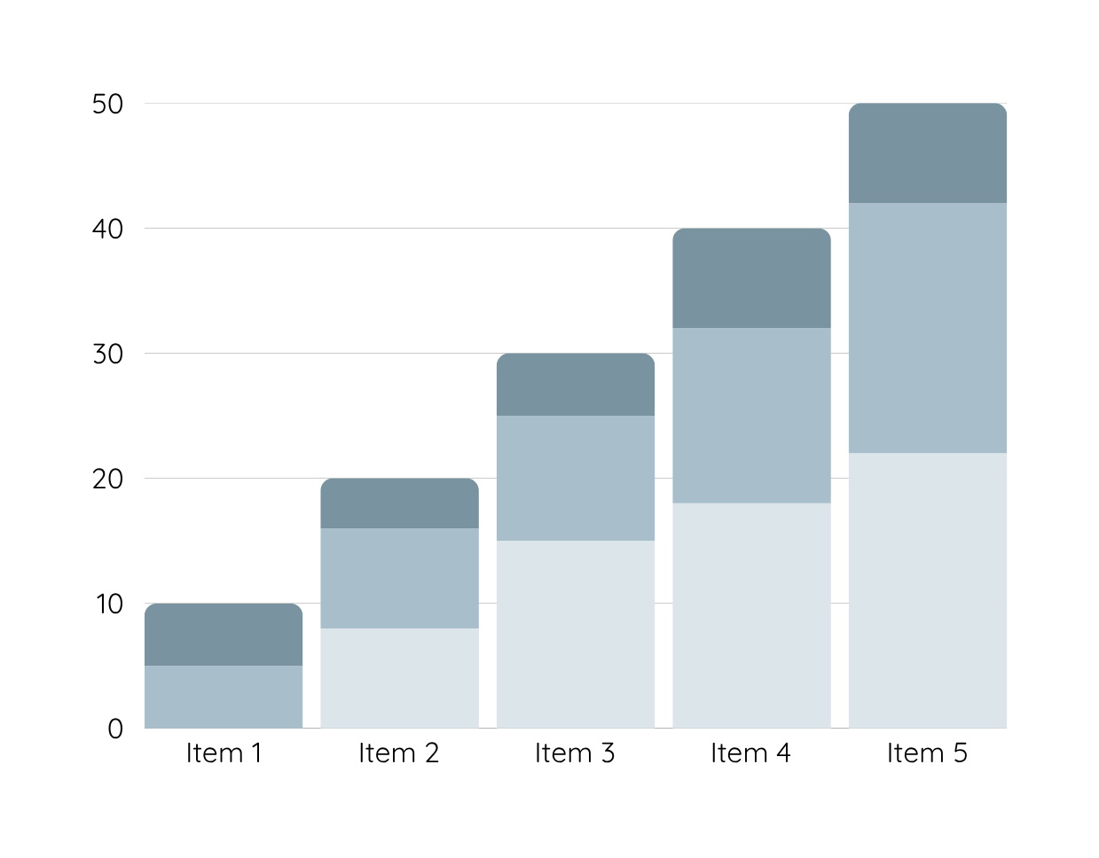
Data Analysis
Over the past year, sales for Warner & Spencer have experienced a consistent decline, dropping month-on-month. The graphical representation of sales volumes reveals a noticeable downward trend, especially in the last quarter.
Product 1
Product 2
Product 3

Slide 32
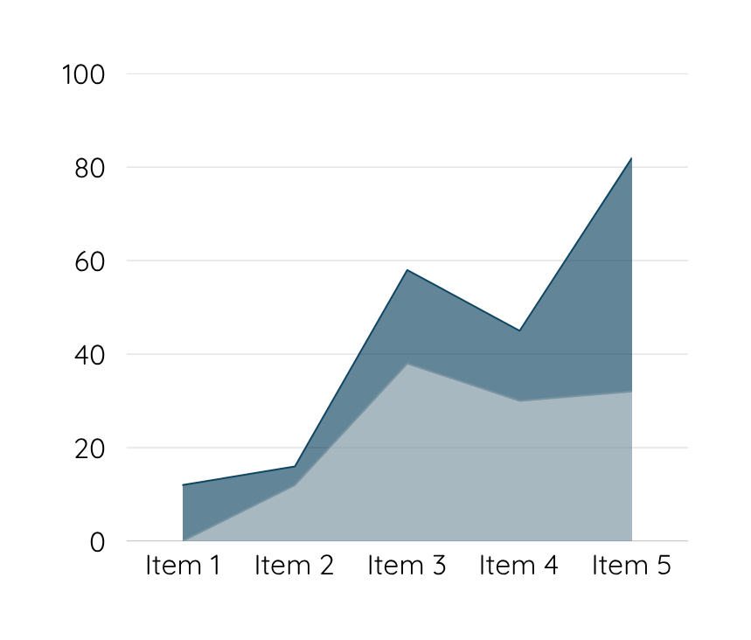
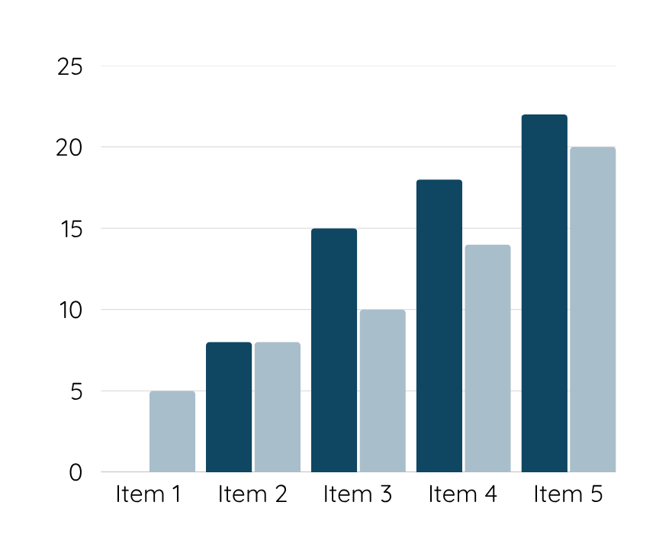
Data Analysis
Customers are unhappy with Warner & Spencer's new packaging, which may be contributing to a decline in sales. Competitors offer better features and pricing, making it difficult for our product to stand out in the market.

Slide 33
Conclusion
By implementing a well-researched and innovative sales strategy, our goal is not only to boost immediate sales figures but also to establish a sustainable framework for continued growth and success.

Slide 34
Thank you

